Slide 1
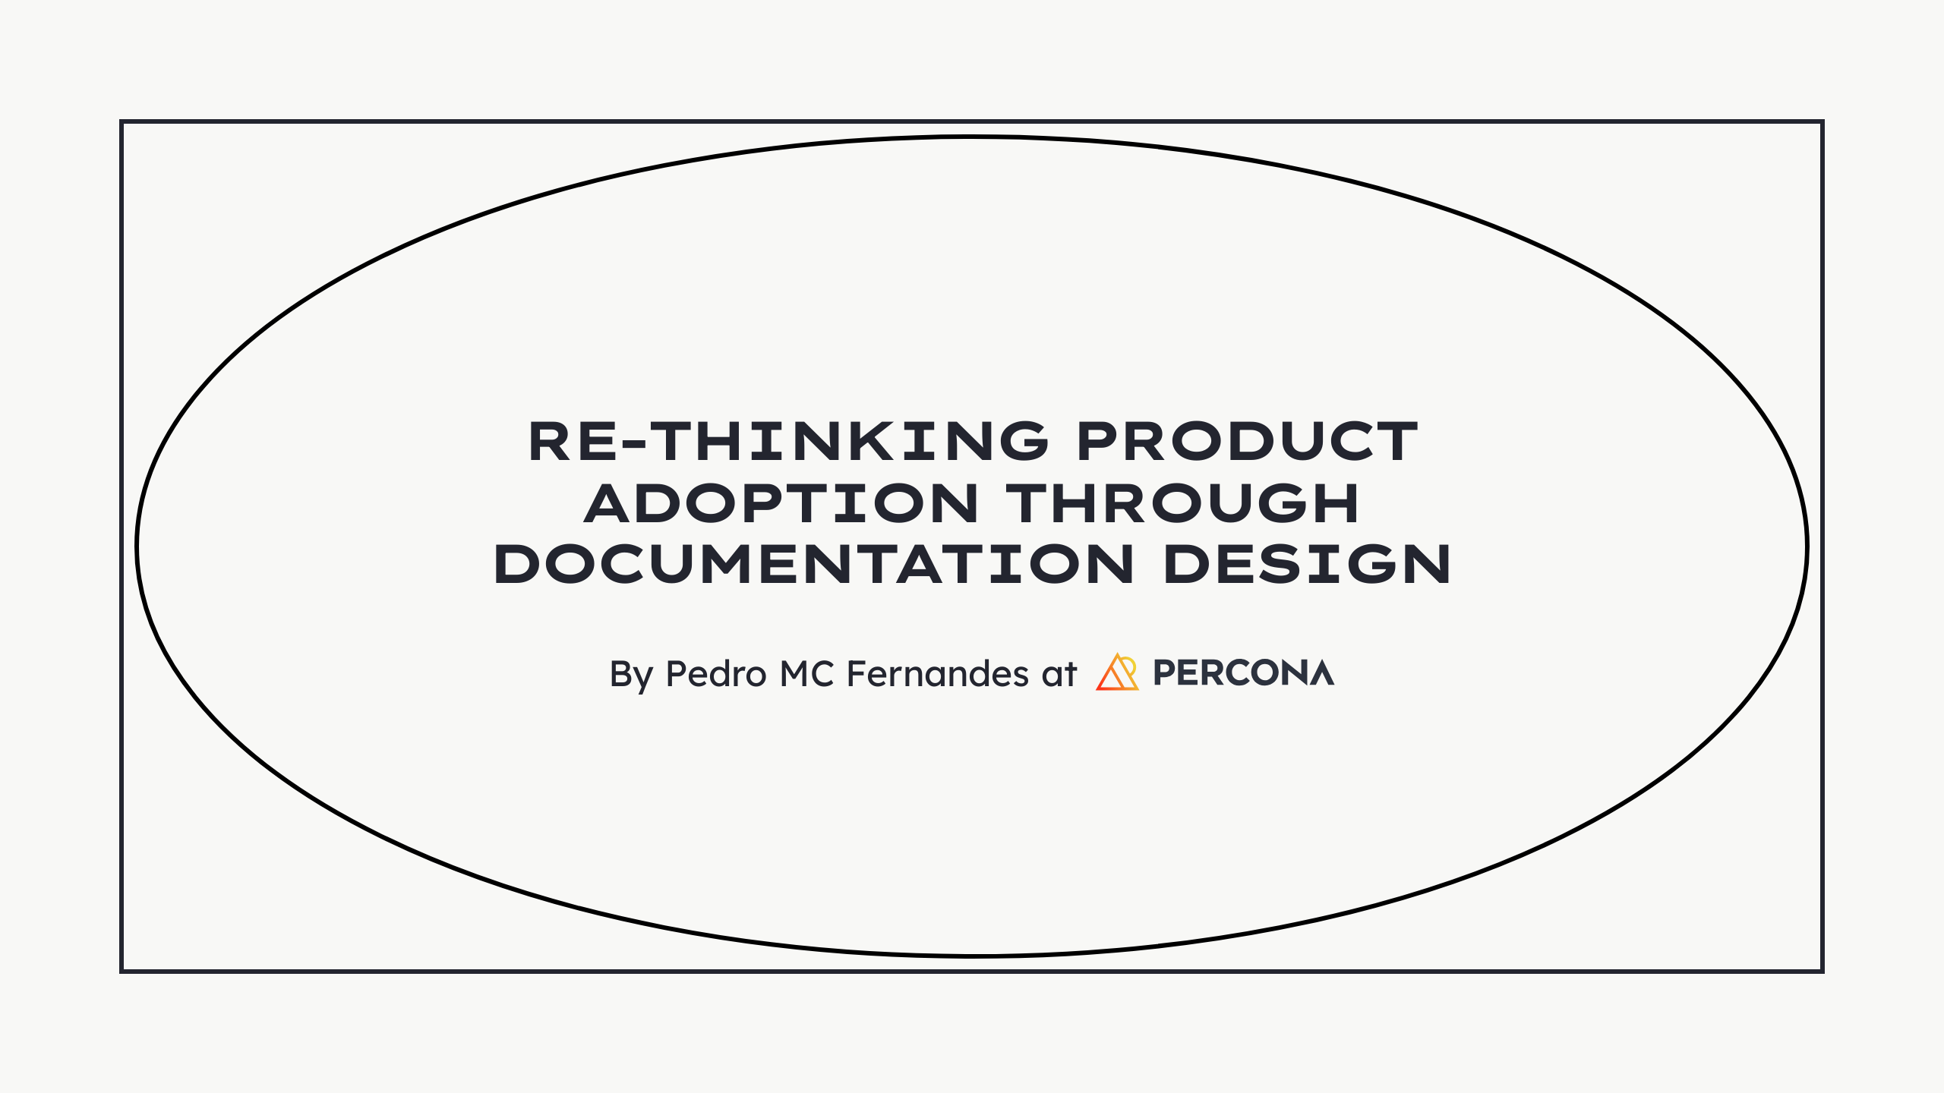

Slide 2
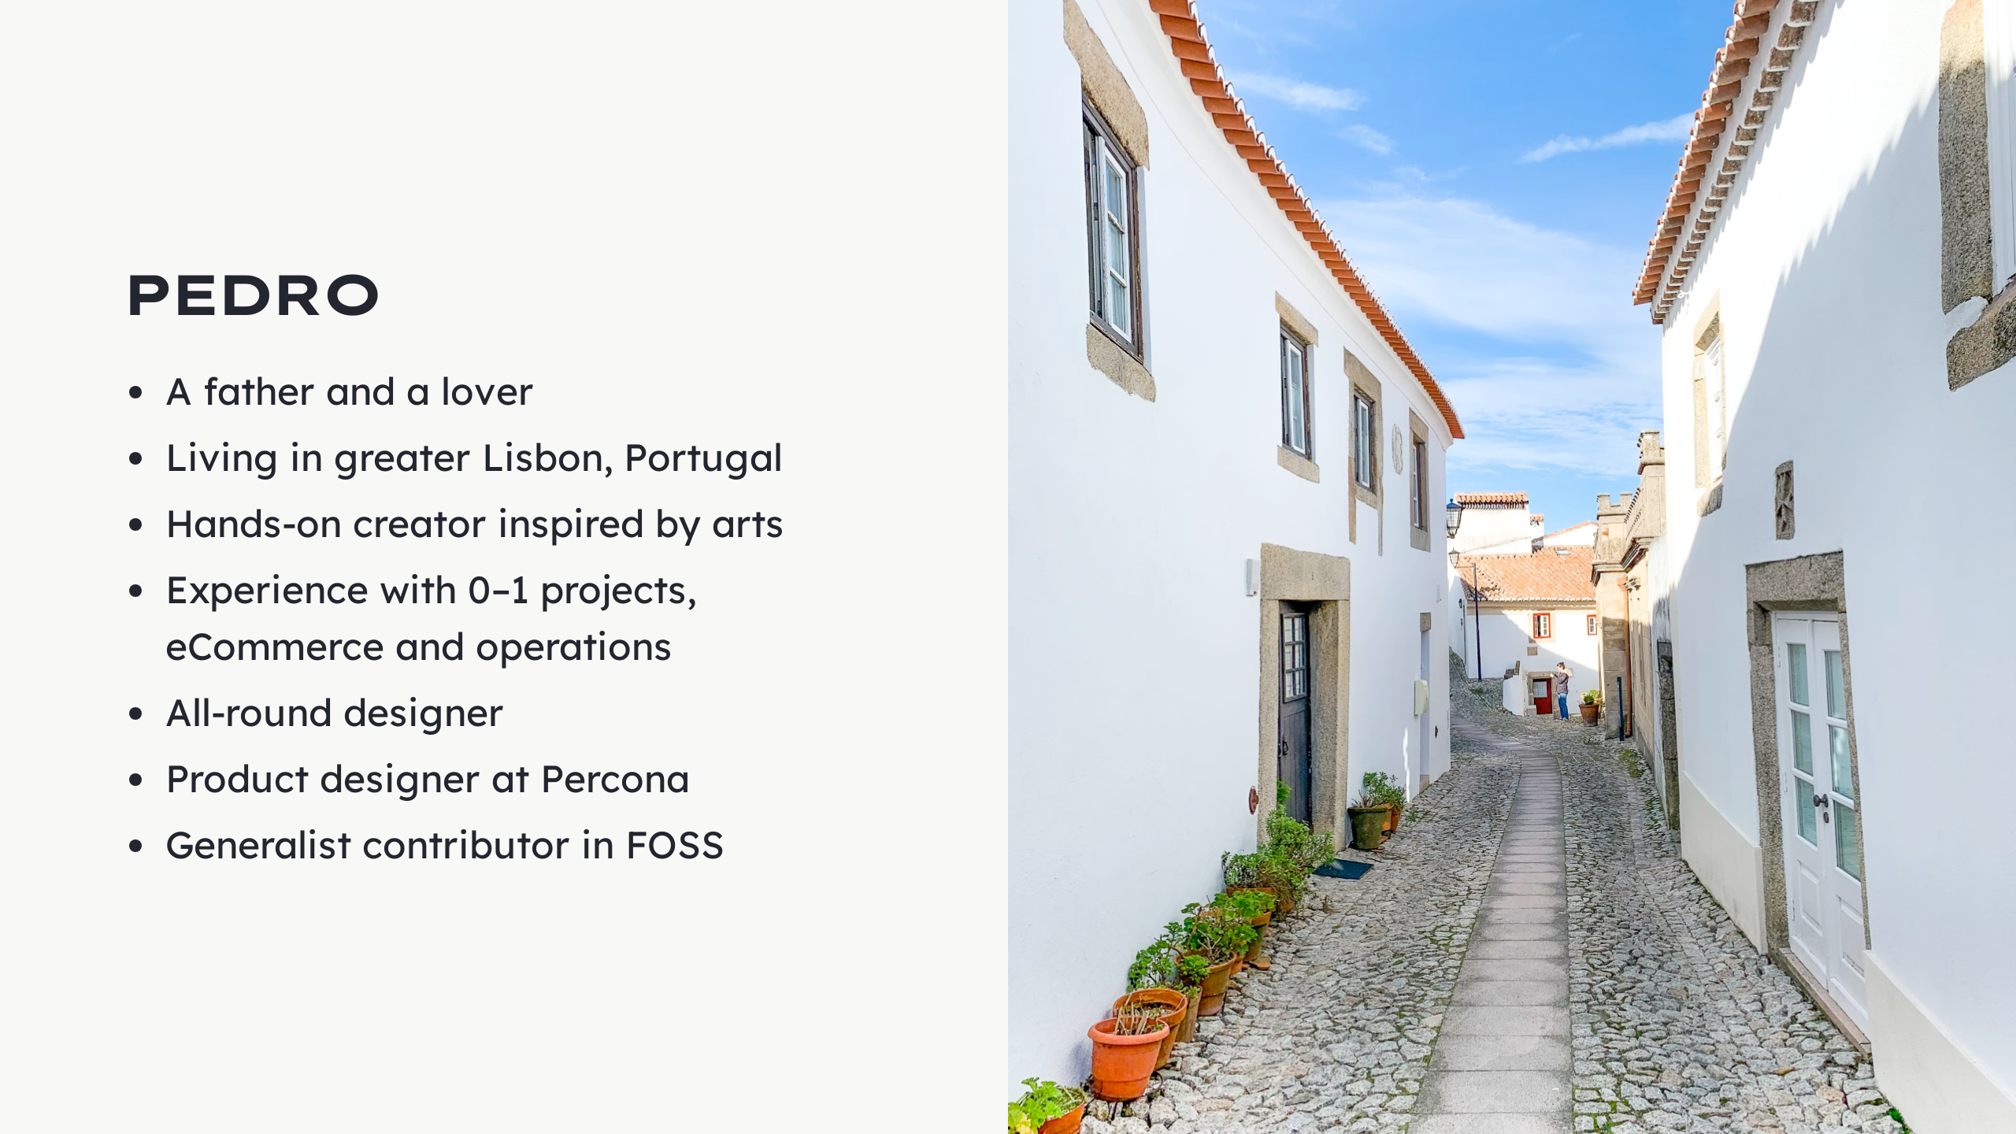
Notes:
Who's Pedro?

Slide 3

Notes:
Where is this happening? - Born out DB solutions - That wouldn't break the bank - For small, growing and large companies - Freedom to choose - Services came 1st - Softwares later - To support services, namely...

Slide 4

Notes:
- In this space - With these services + open source products - Why would we want to shape docs? - Why improve them? - Why would we care about docs 1st and software growth later?

Slide 5

Notes:
Here are some of our motivations: - We want databases for everyone - Any technical background - Spark their creativity - Help them learn how to do databases - Promote independence - Lower the entry barrier - Get users happy - Reduce effort and time spent with databases - More and better contributions - Increase the discussion - Multiply solutions - Optimization of the Support - Support focused on bigger problem - Urgent problems - Societal blockers - Don’t break the bank - Anyone can get in - Grow at their pace - Scale when ready Documentation can help. Easier to consume docs -> soothe the experience = more users.

Slide 6
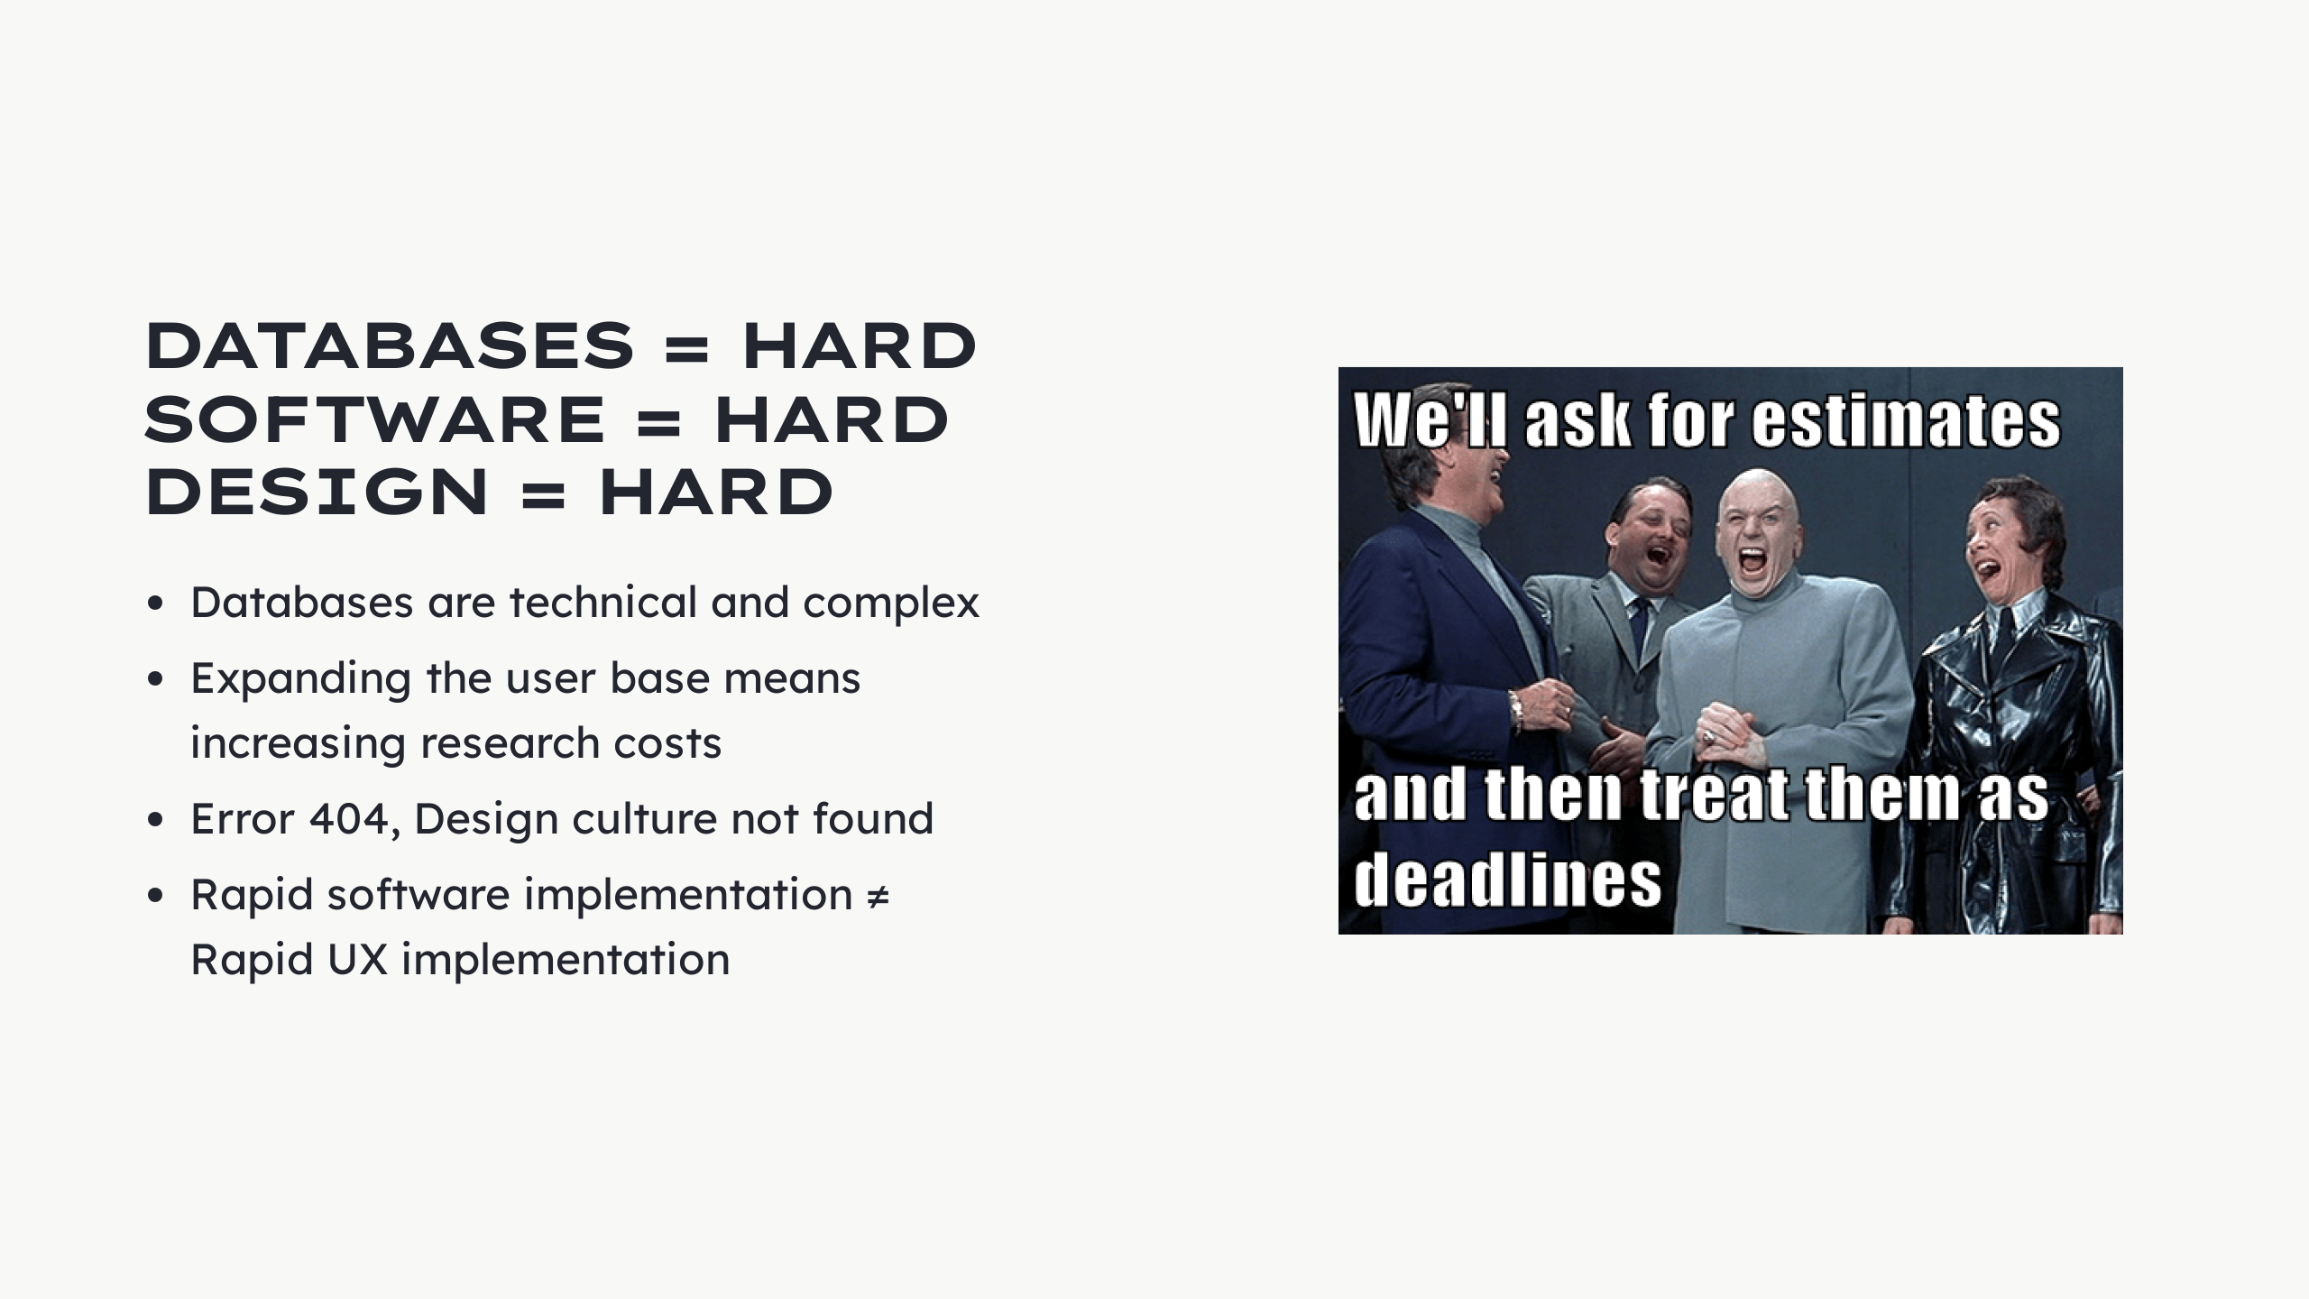
Notes:
- Databases = technical + complex - Intimidating - Specific terminology - Abstract structures - Complexity <- user centricity - Documentation can - Demystify - Reach more people - Increase user base = + research costs - More people to know - More talk - More opinions - More synthesis capacity - More time spent - Research is - Crucial for software dev - Crucial for user-centricity - Crucial for adoption - Error 404, Design culture not found - Percona - Wasn't born user-centric - Focused on technical solutions - Working/not working things - A UX team is (again) costly - UX outputs does not directly correlate to biz numbers - Needs holistic evaluation - Needs deep integration - Team - Processes - + Time spent - Rapid software implementation ≠ Rapid UX implementation - If they're not synchronized - UX design - More iterative by nature - Invests in accuracy - Shoves in more value With all of this... Capacity is limited and growth is a gradual process, not immediate. - Time is short - UX teams can't get everywhere at the beginning - A lot of groundwork is due

Slide 7
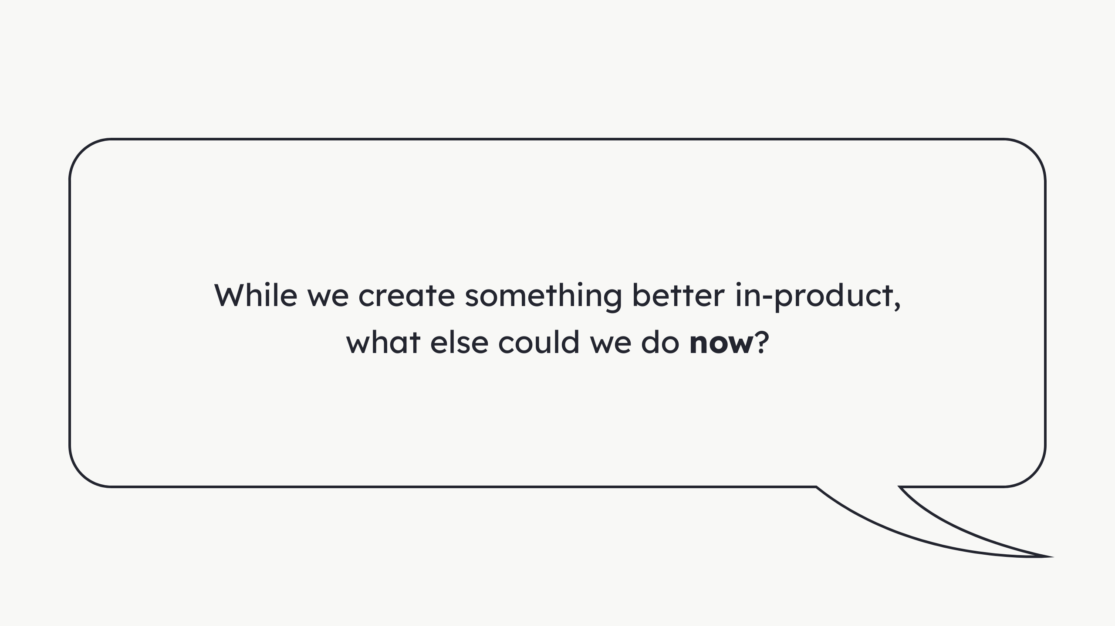
Notes:
Thinking... - Growing software takes time - Capacity is limited - A lot of UX debt - Time is (always) short What else?

Slide 8

Notes:
Ikea Billy bookshelf with Oxberg doors. Anyone had a chance of assembling one of these? Was it hard? Did you had to go back because you were doing it the wrong way? I did. I nailed the back, faced the wrong direction. Wood grain, unpainted from the inside. Had to get some more of those micro nails... So, imagine assembling this...

Slide 9

Notes:
...Where each part goes. It would be a lot of work, from my lazy handyman POV. I also made all the doors one sided. When i was about to install them, i couldn't. They were all either left or right doors, don't remember. I had to unscrew everything, leaving the door a little big ugly, chipped from the inside.

Slide 10
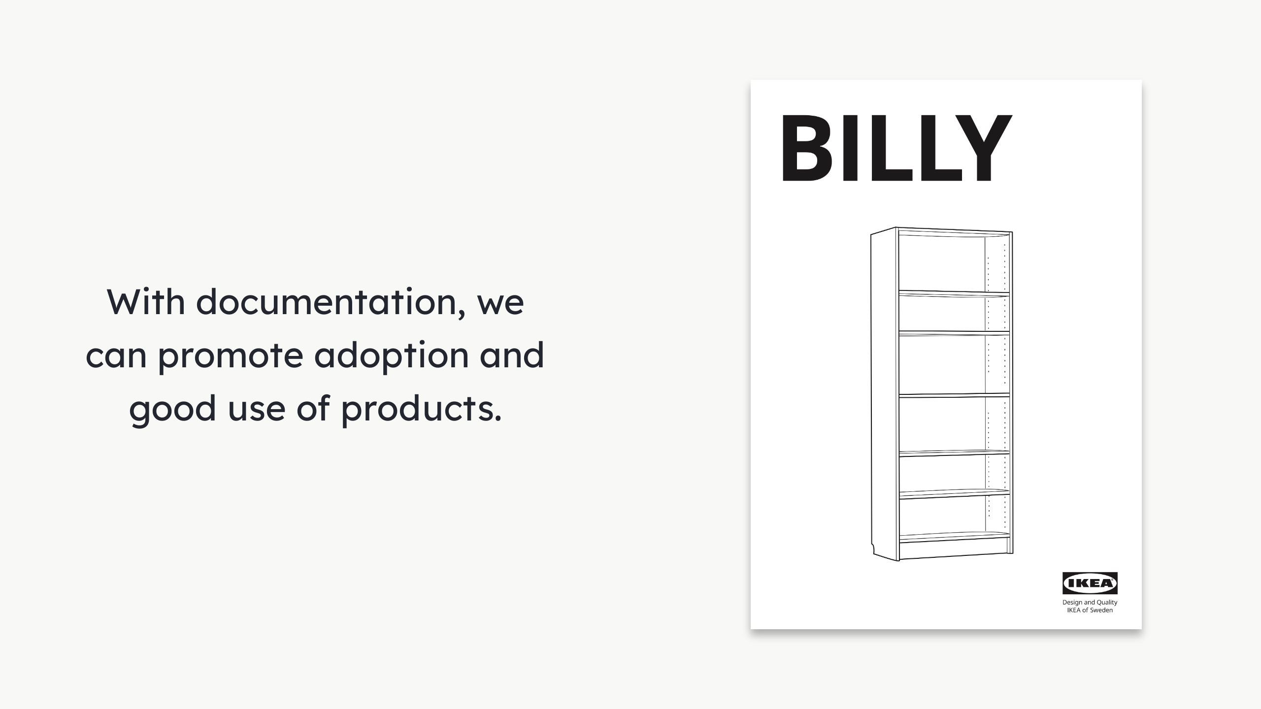
Notes:
So, even with well designed documentation, like IKEA's, errors can still happen. I still think it's a beautifully designed instructions booklet.

Slide 11

Notes:
With database development -> complexity = high. 1. Installation 2. Development, management and monitoring 1. An entire world 2. Connections to make 3. Components to upgrade 4. Queries to optimize 5. Security concerns 6. Performance concerns 7. And more 3. Application 1. Maintain 2. Optimize

Slide 12

Notes:
Share: - What we did - What we learned - What we think - Open the discussion - Spark ideas

Slide 13
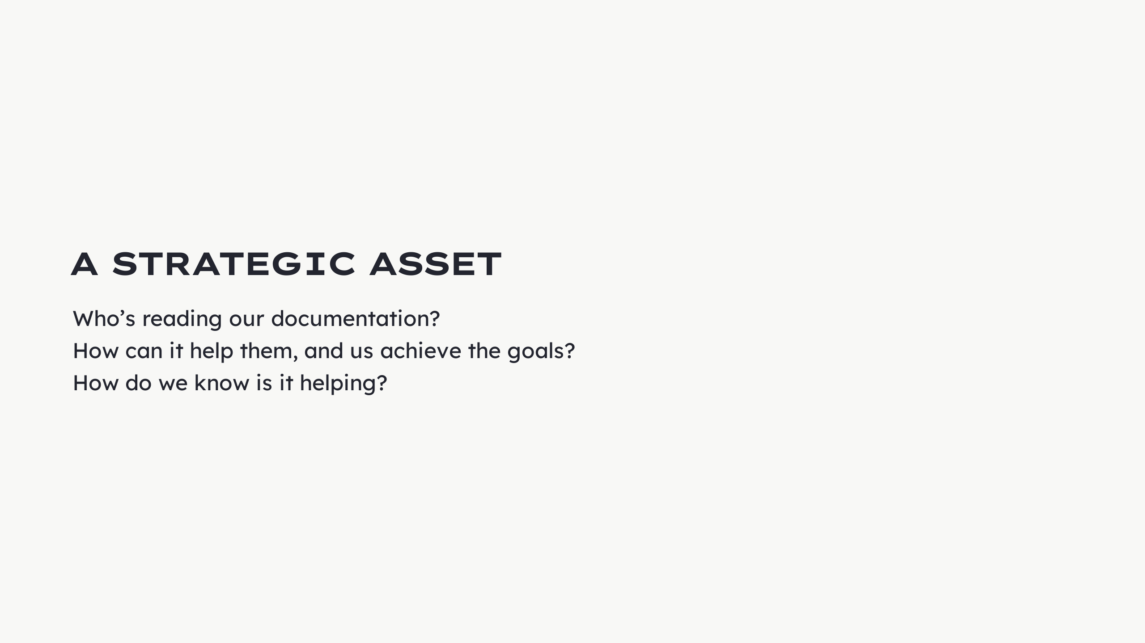
Notes:
We didn't have a clear strategy. Documentation was not an instrument to achieve goals. We wanted to change that and ask...

Slide 14
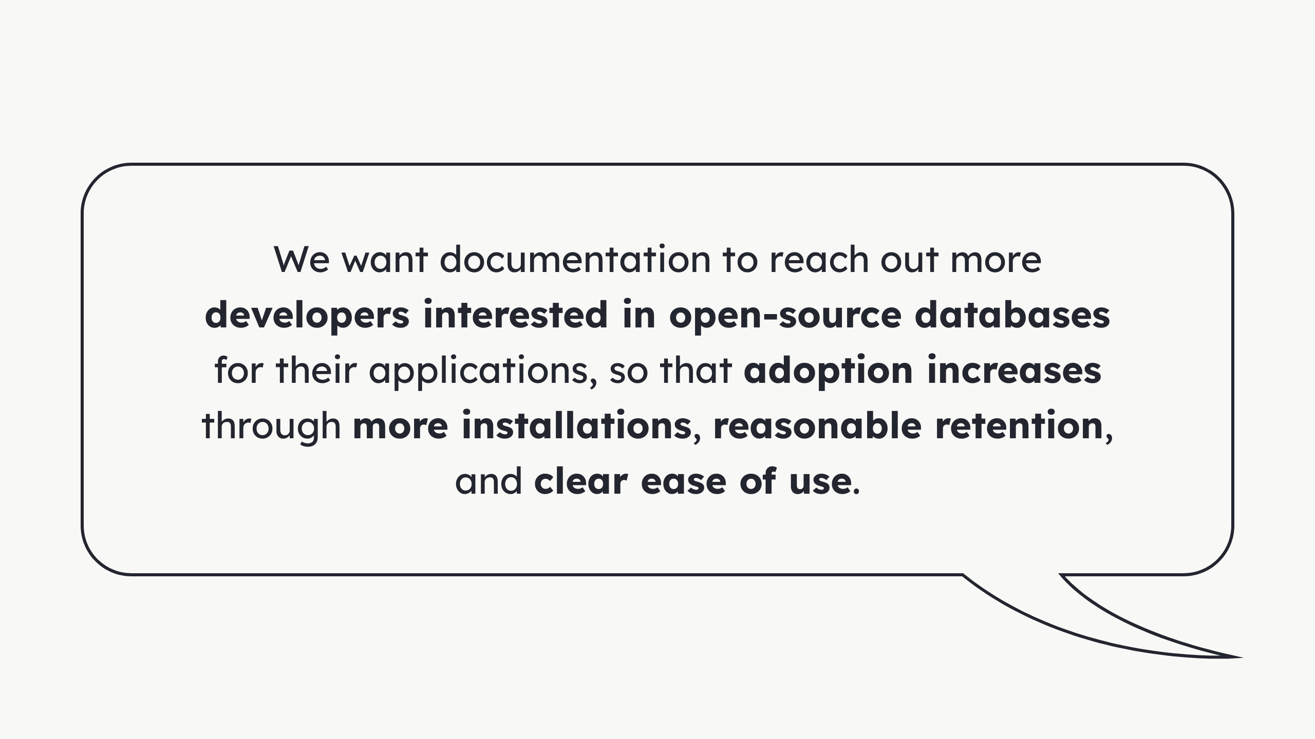
Notes:
Focus on developers. Not database administrators nor reliability engineers. They continue to be our focus, but we wanted to reach this user base. We understand that more a more developers need these alternatives and some independence.

Slide 15
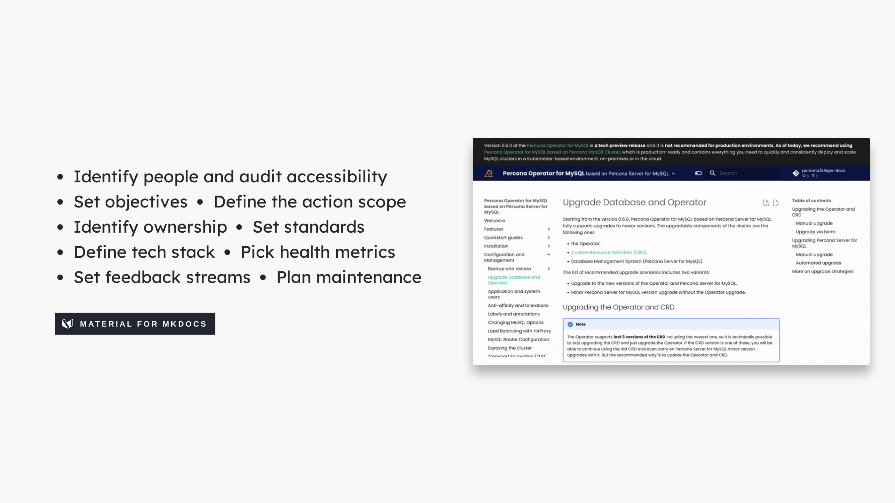
Notes:
Strategy: You can go as detailed or as lightweight as you wish. We believe the important is an form of agreement of what we are doing. Sometimes a simpler but mature, sucinct sentence is sufficient to help motivate. List of topics: This is also a load of work, but shows a bit more of the strategic spectrum. You could go as far as needed. On the right hand side, a preview of our old documentation. We inherited the documentation in MkDocs with the Material theme. We're pretty happy with it and it's very flexible. There are tons of alternatives out there.

Slide 16
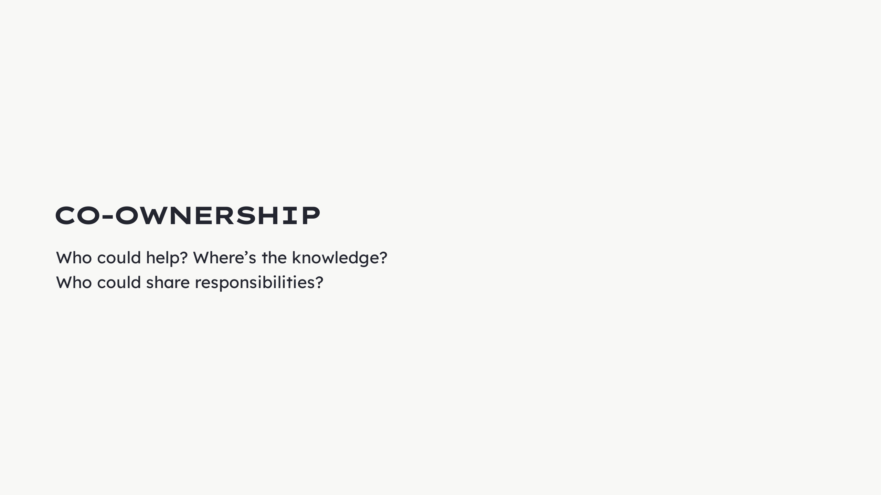
Notes:
Another problem: The documentation just existed for the sake of knowing documentation had to exist. This is not enough - if - We want to improve. The result: We only had the absolute minimum to keep documentation alive.

Slide 17
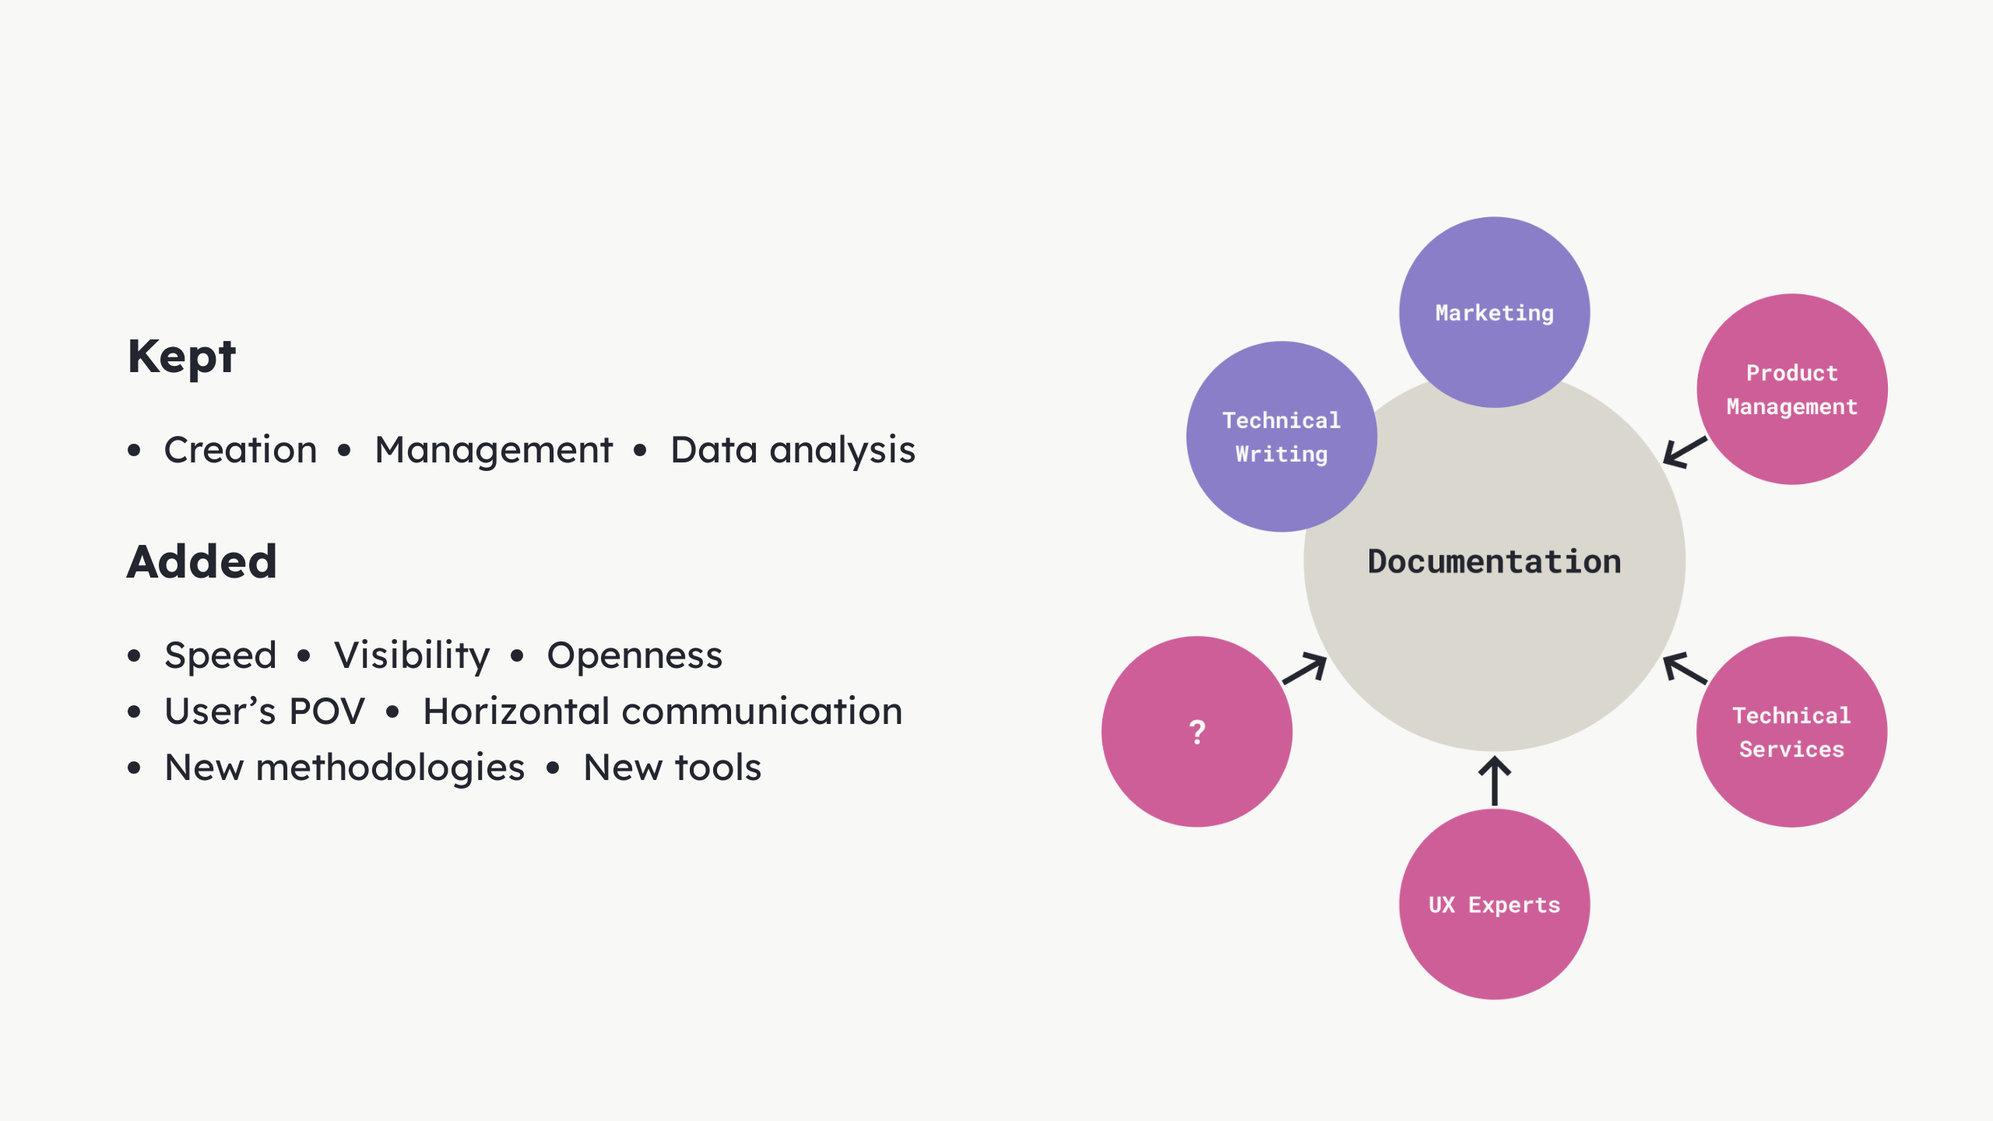
Notes:
Only: Technical Writers + Marketing We kept: Read We added: - Speed + visibility + openness - More people seeing - Recognizing the importance - Wanting to contribute - We shared all outputs with the team - Brought user representation - Technical Services - Account managers - Customer success - And more opinions and empirical knowledge - PMs helped - Draw the attention - Move things - Get resources - Product POV - UX team - New ways of doing - Explored new tools - Posthog - Proposed solutions

Slide 18
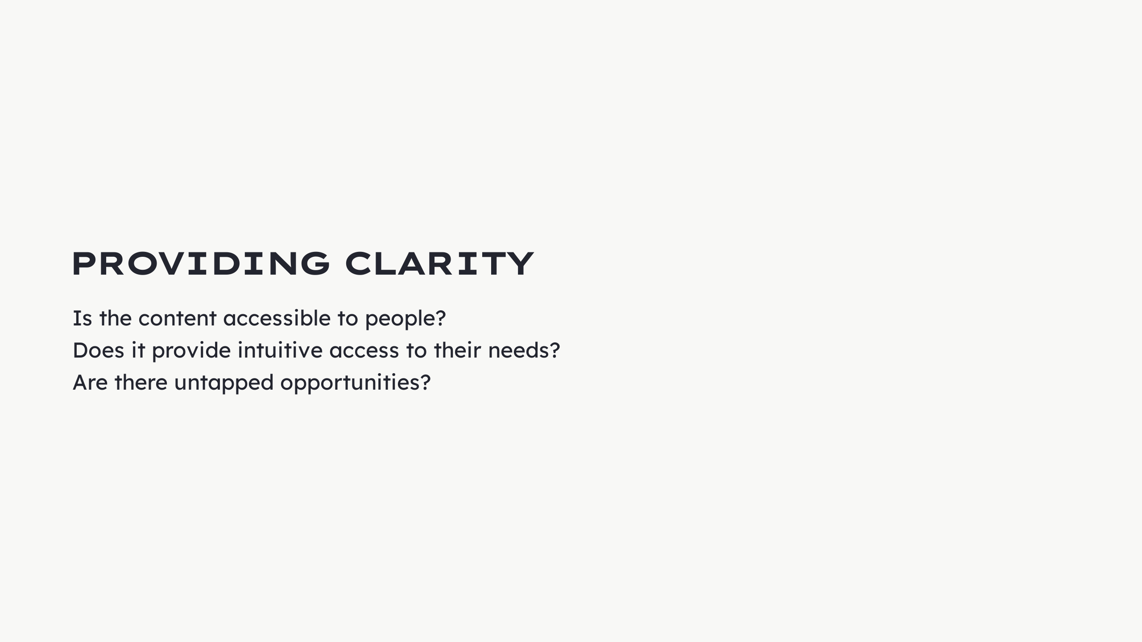
Notes:
We audited the websites implementation and designs from our UX POV. We immediately found opportunities to improve. We wanted to ask...

Slide 19
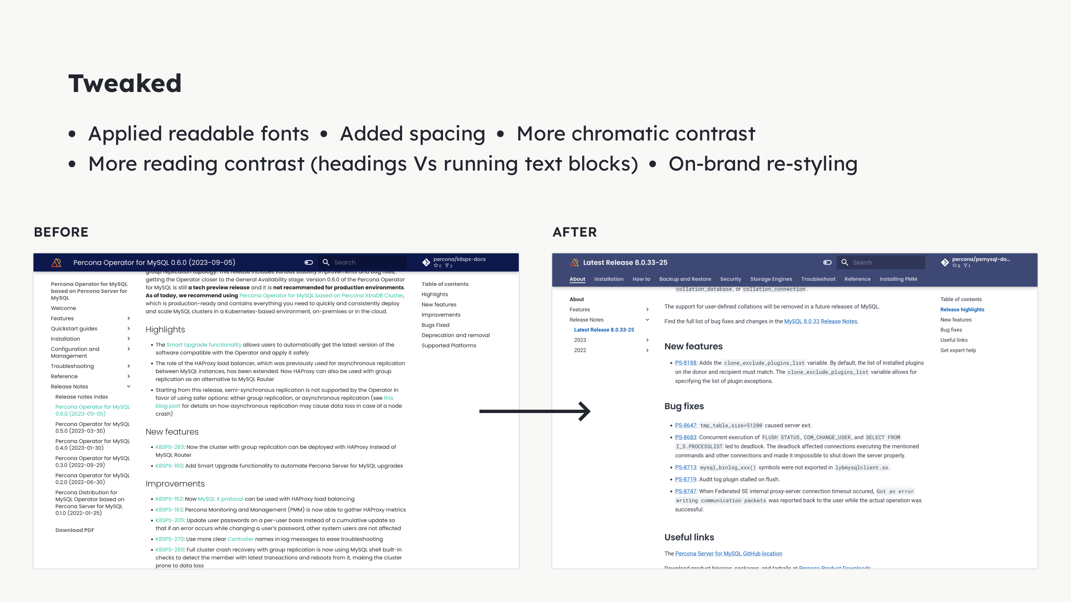
Notes:
- Reading: Geometric -> Grotesque - Kept Geometric for headings - Boosted contrast on headings - Added more spacing - Made hyperlinks for accessible - Barely perceivable on the left

Slide 20
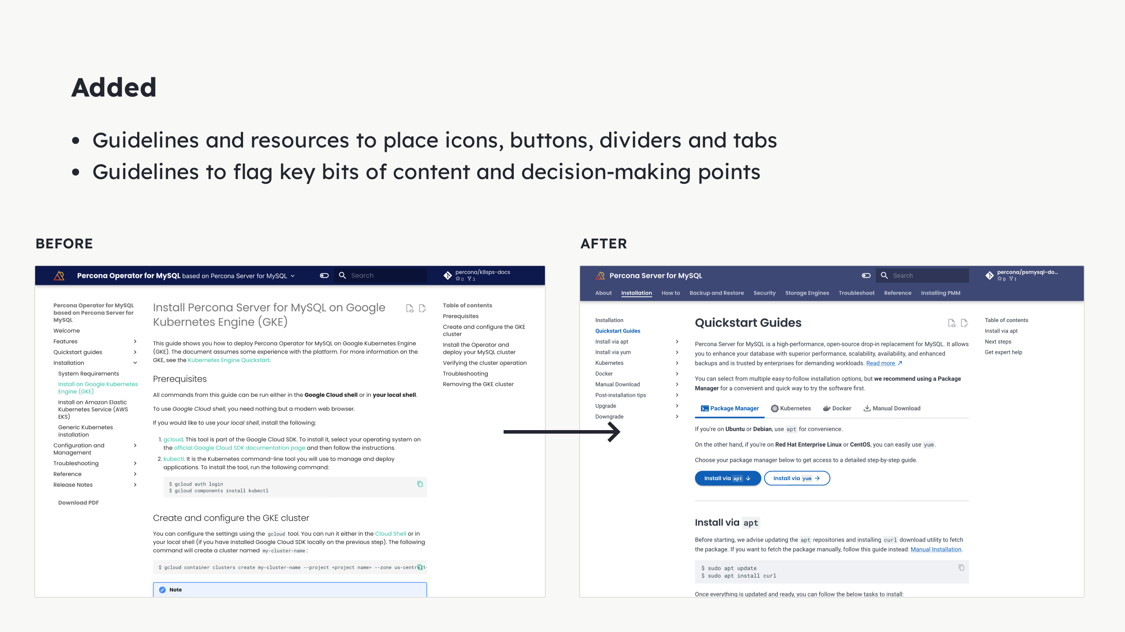
Notes:
We were not using the full potential of MkDocs. We made sure to provide guidance on how to apply more elements, because the maintainers (tech writers) were not as well versed on visual arrangement. We were open to help decide.

Slide 21
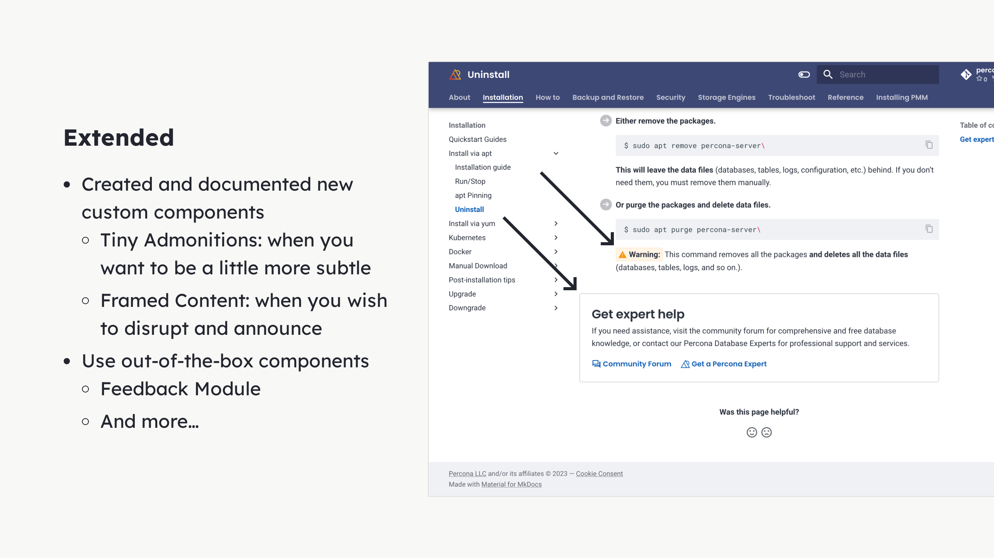
Notes:
This MkDocs theme is great out of the box, but we wanted more. Created extensions that made shaped the content to our liking and in a motivation to help users. Also digged deep to find components that were not in use but would help immensely, like the feedback module.

Slide 22
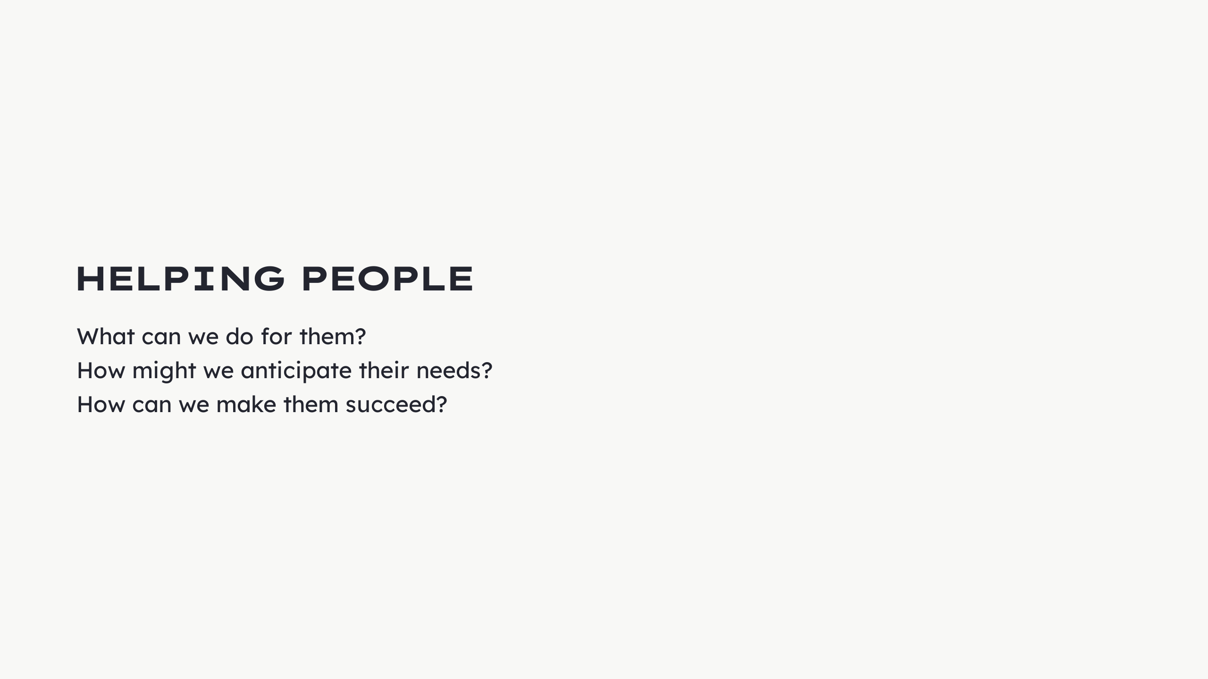

Slide 23
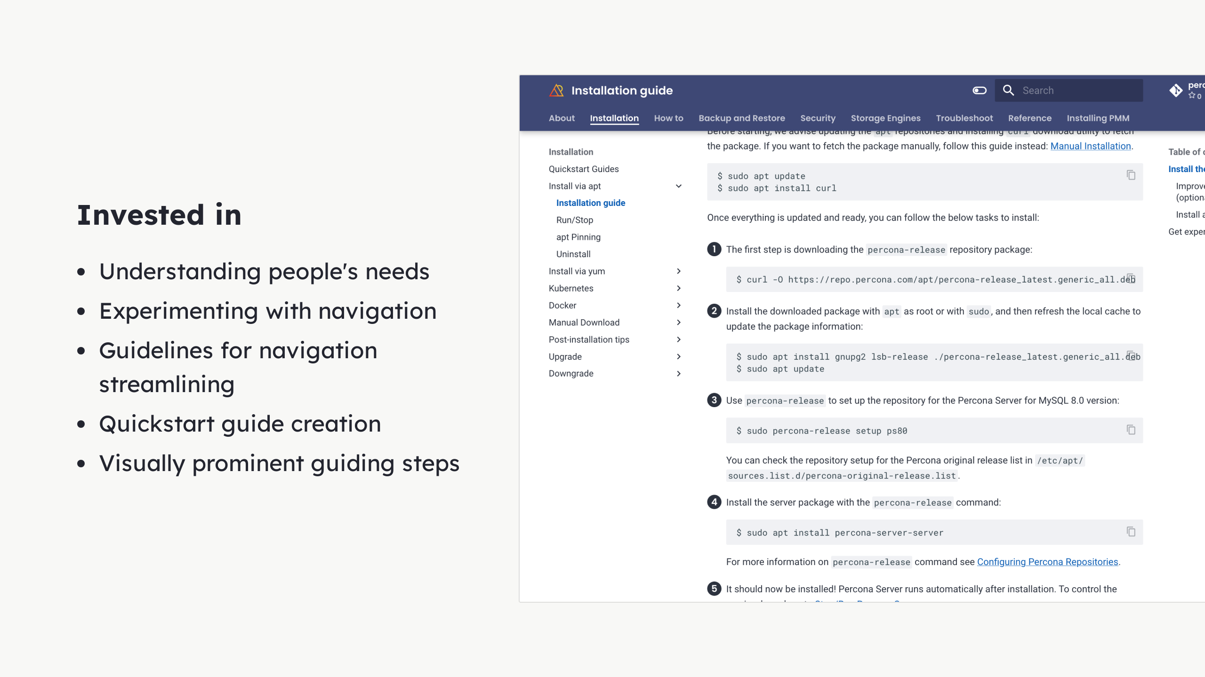
Notes:
We talked with people and experts to understand their needs. We did experiments a bunch of testing with navigation. For example, this top navigation (horizontal) + side navigation (vertical) was disapproved. We found that users felt confused navigating so many sections through 2 distinct patterns. They wouldn't know where is what. So we decided to generate guidelines that would focus on making the sidebar navigation the best navigation possible. We also helped create quickstart guides, guiving pointers on how to guide users into installing in a quick and clear way, so they could get to enjoy the product fast. That is why we also created some visual cues in the quickstart guides (numbered bullet points).

Slide 24
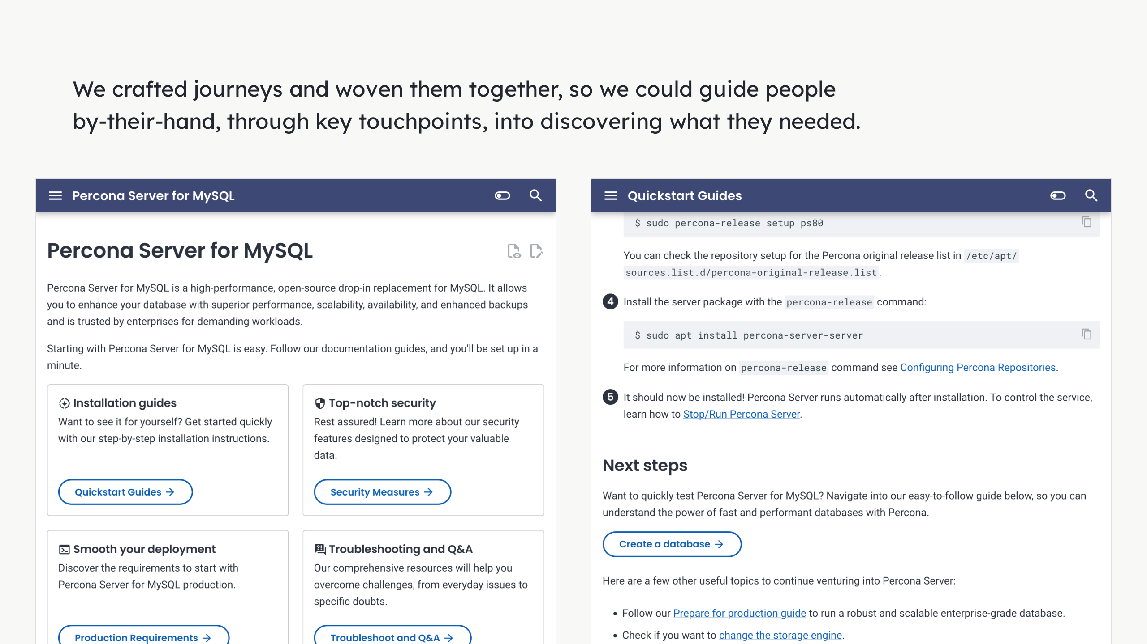
Notes:
We used all of these visual cues we have created. We applied them were it made sense. The objective was to signpost the most likely journey to the user. While always providing alternative routes.

Slide 25
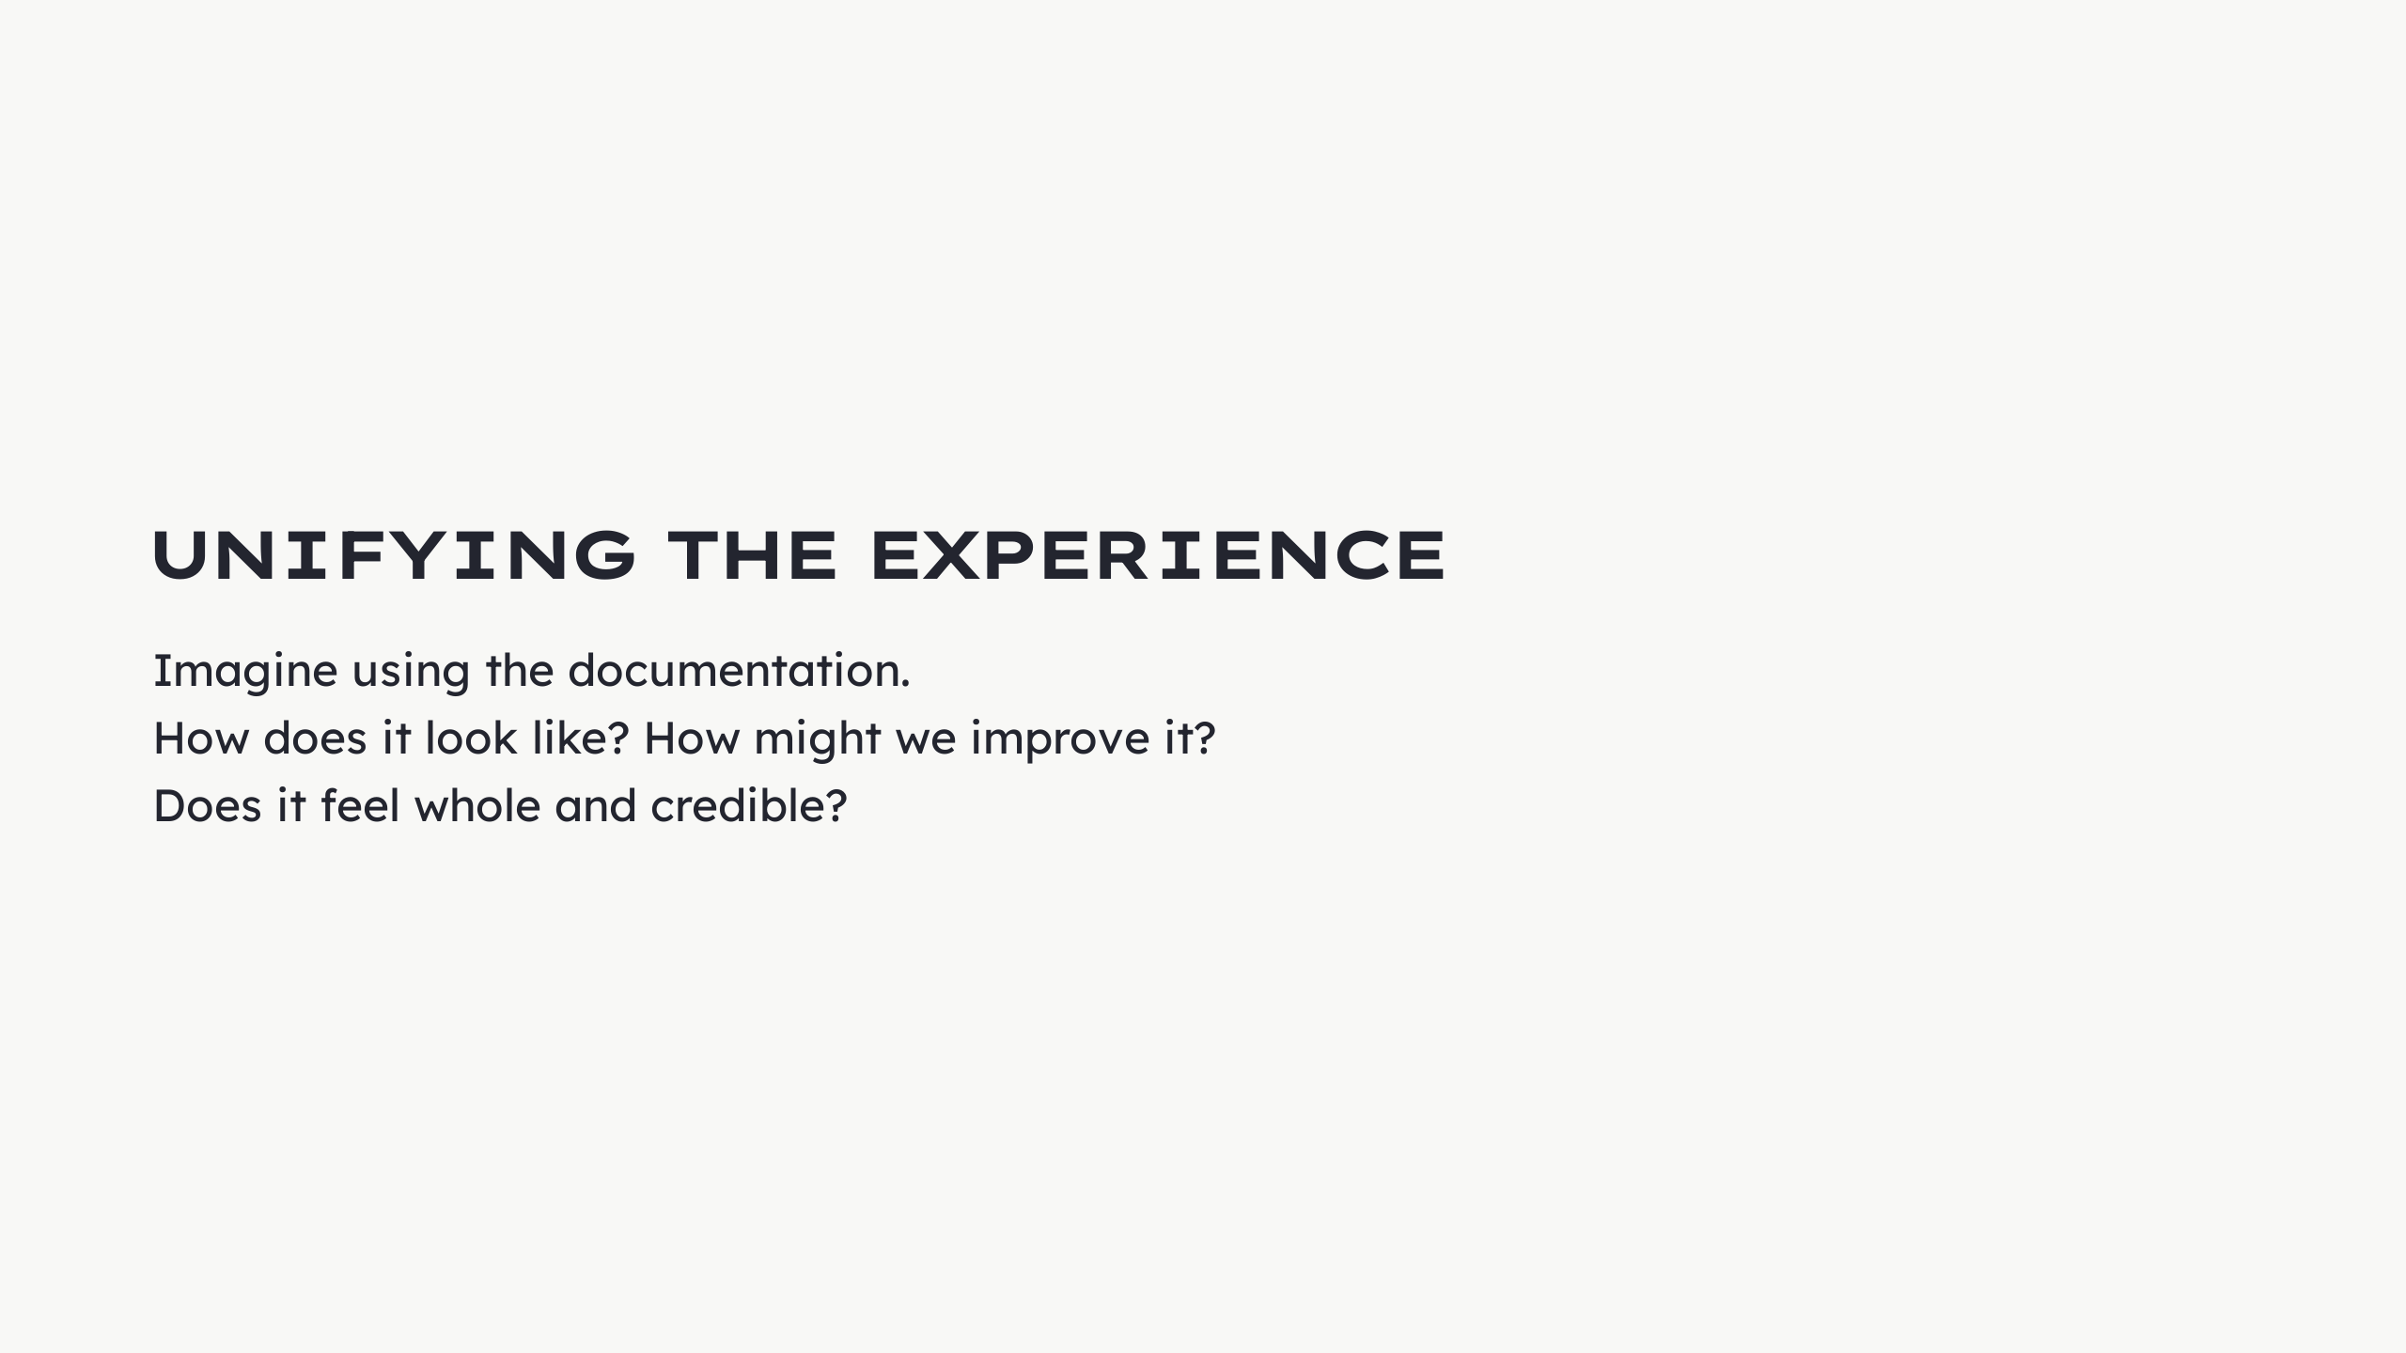

Slide 26
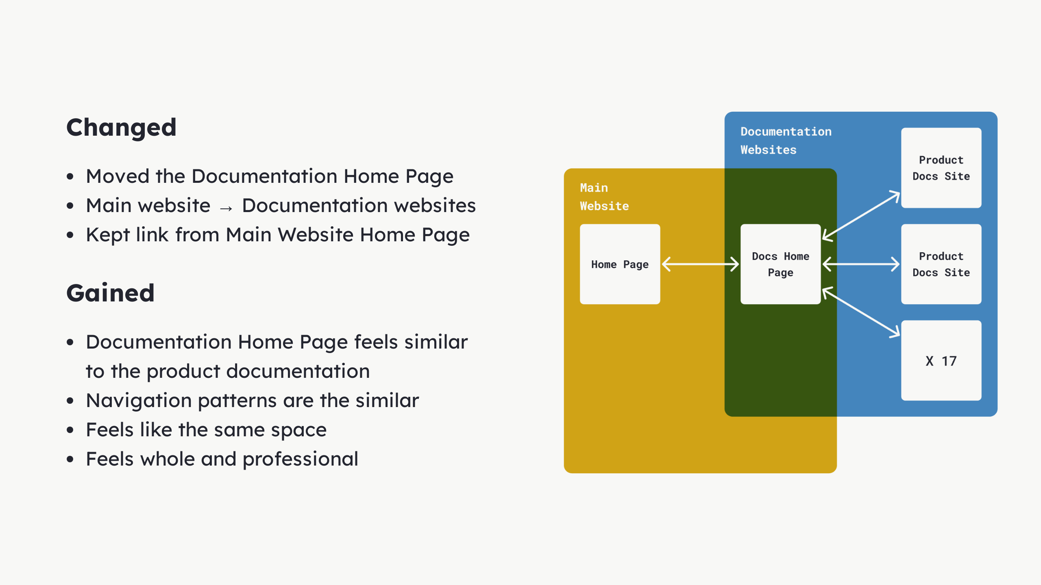
Notes:
Our elephant in the room: Because we left documentation kind of left by chance, its sitemap was disconnected. Actually, the homepage for the documentation was in the main website. It was one of the website pages. To navigate between 2 products, you had to jump websites. You could notice the huge difference. We decided to move the actual homepage for the docs to the same area where all other documentation websites were. We wanted the homepage to feel part of the documentation and not part of the main website. Share the same styling and usability patterns. This would help make it feel whole. This would boost the aesthetic-usability effect by making users perceive our documentation as a solid and effective one. This is our hypothesis.

Slide 27
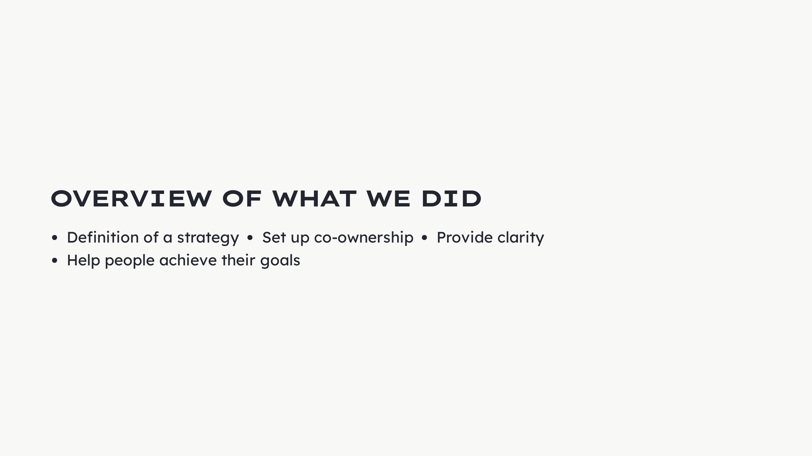
Notes:
- Definition of a strategy - Generate consensus - Set up co-ownership - Share responsibility - Garner expertise - Provide clarity - Readable - Accessible - Help people achieve their goals - Understand their needs through research

Slide 28
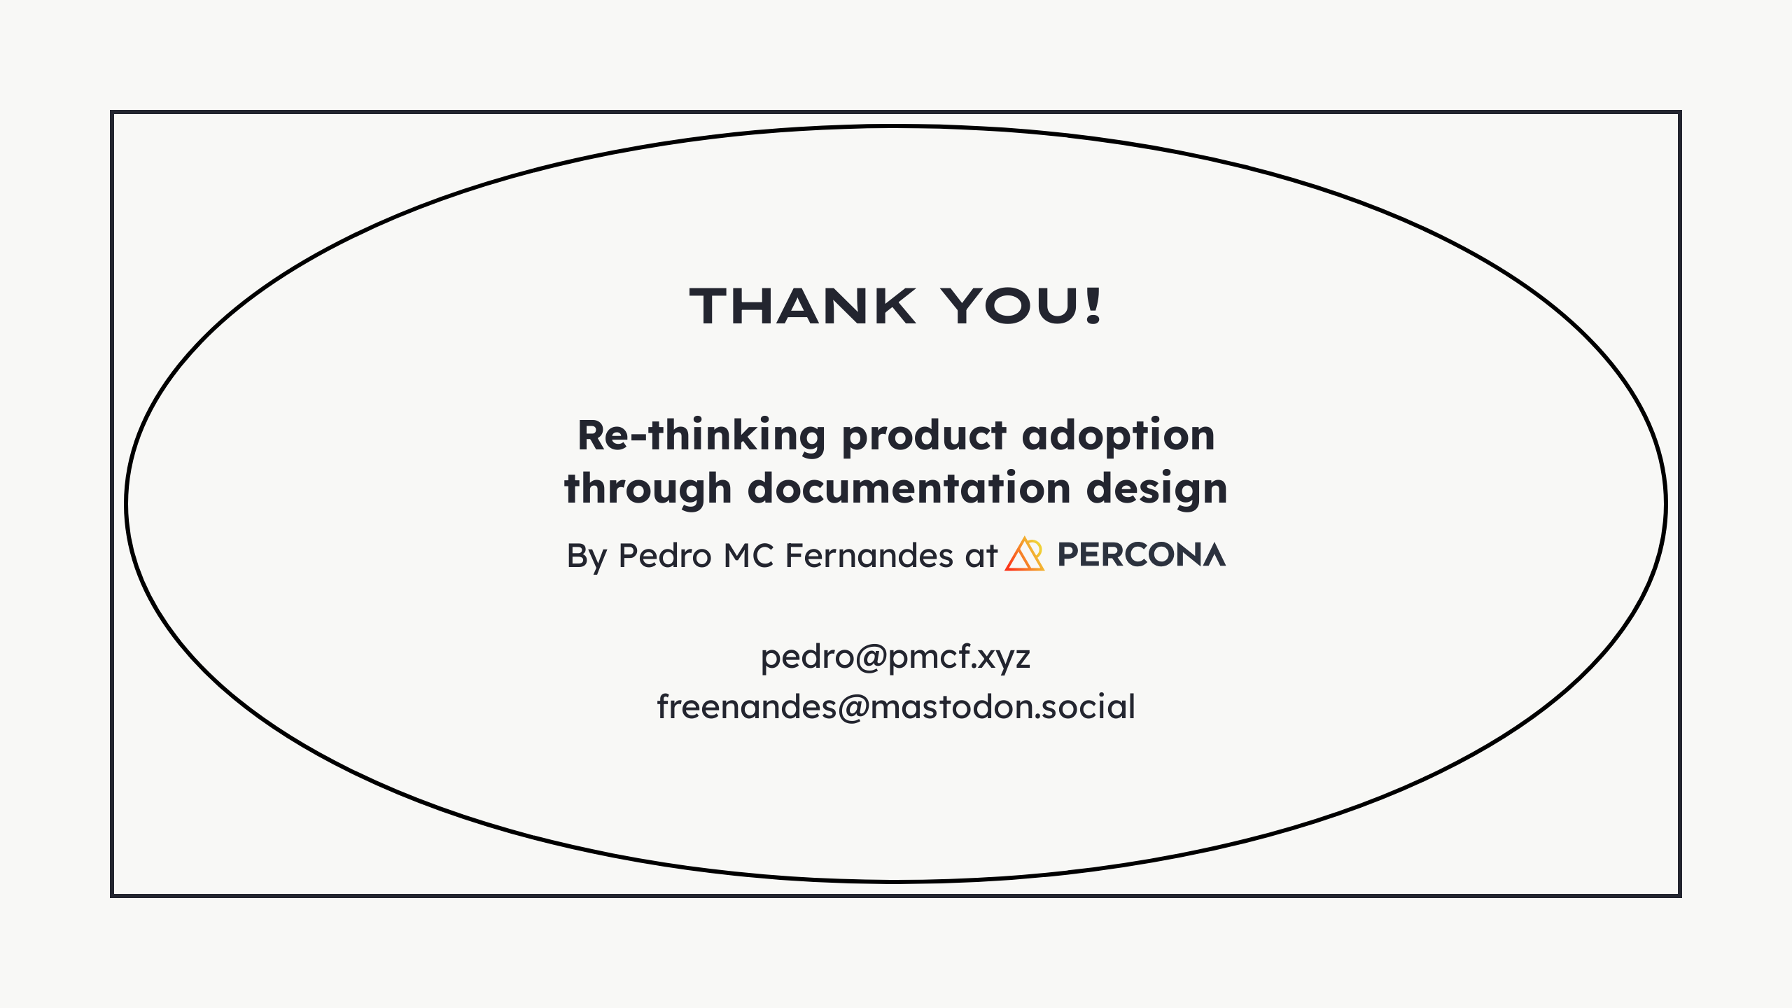

Slide 29
